Slide 1
Analyzing “Cleaner” apps
By: Nick Brink, Promise James, Alex Levin, Hunter Sisson, Jacob Smith

Slide 2


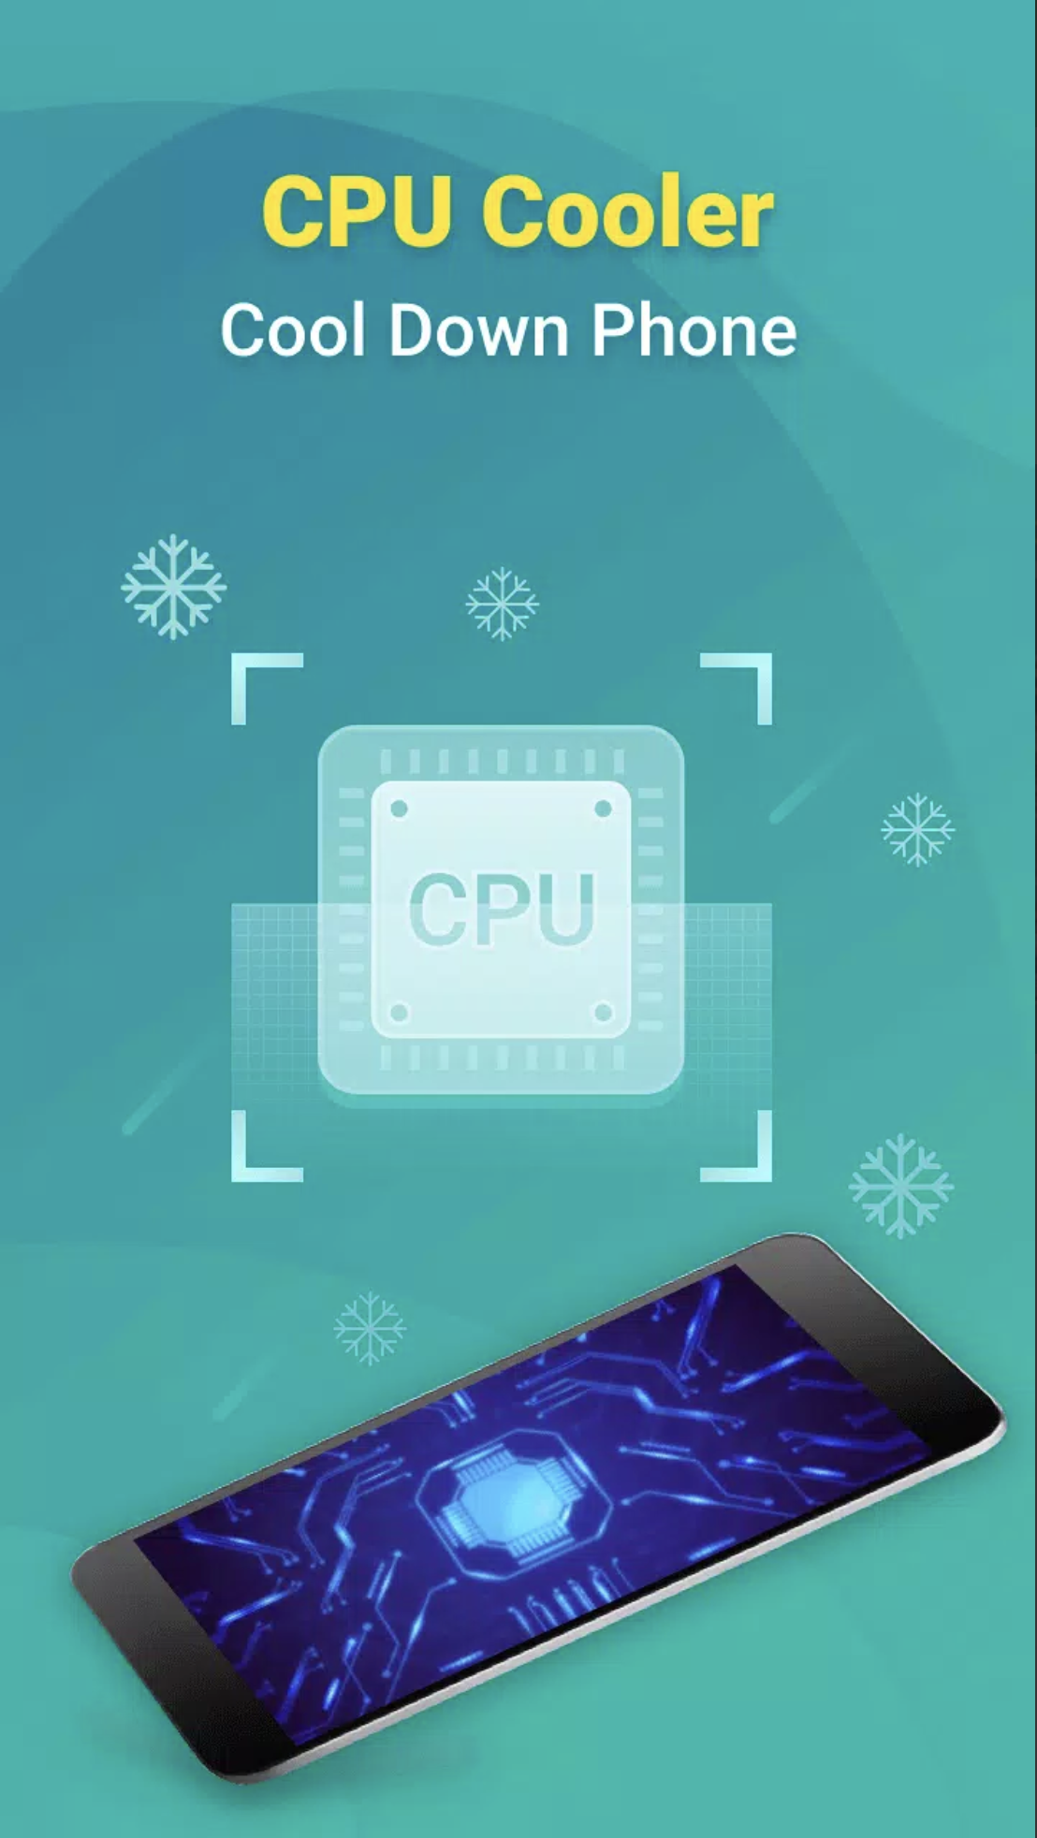

What are “Cleaner” apps?
Cleaner apps are Android applications that claim to improve device performance by:
Freeing up storage space
Speeding up RAM usage
Cooling down the cpu
Managing battery consumption
Provide antivirus or security protection

Slide 3
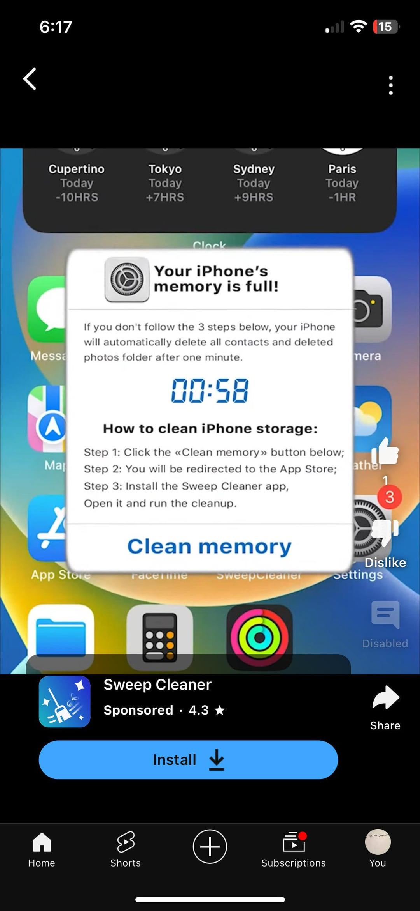
Why are these popular?
Marketed to those with older devices, with advertisements such as this:
Appealing UX and UI, with features showing “optimization” stats
Promise instant results with one-tap

Slide 4
Why can these apps be dangerous?
Nearly all of these apps request excessive or dangerous permissions
  GET_TASKS, WRITE_EXTERNAL_STORAGE, READ_EXTERNAL_STORAGE, WRITE_SETTINGS, etc.
Some are malicious
  Distribute trojans or spyware
  Serve as a vector for
    Phishing
    Credential Theft
    Ad Fraud

Slide 5
Research Questions
Of the apps that we have selected,
What permissions do they request and why?
How many of them malicious?
What are they malicious apps doing?

Slide 6
Methodology

Slide 7
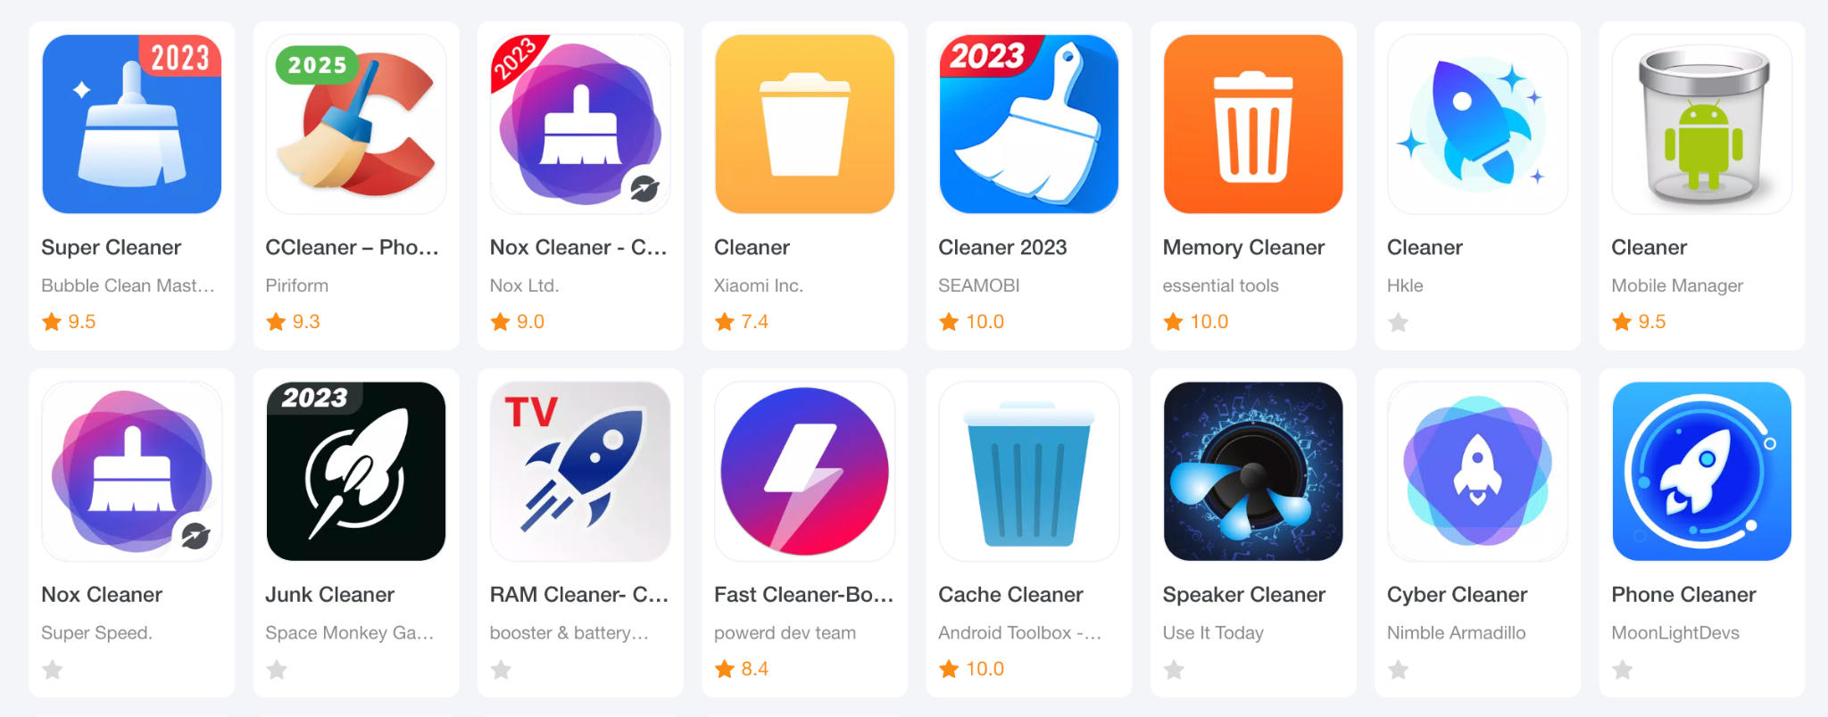
App Selection
Apps were chosen from APKPure
  4 apps per group member, 20 in total
Have to claim to do some sort of “cleaning” on phone

Slide 8
Static and Dynamic Analysis Tools - MobSF
Permissions
Android API usage
Behaviour analysis
Server locations

Slide 9
Static and Dynamic Analysis Tools - Virustotal
Scans APKs using 70+ antivirus engines, increasing the chance of detecting known malware signatures
Sandbox behavior reports, showing what the app tries to do when executed
Threat Graph, which helps visualize the app’s activity

Slide 10
Tracking Structure
Google Drive where all apk files are stored, along with their MobSF Reports
Google Sheet where app statistics were compiled

Slide 11
Statistical Findings

Slide 12

Permissions Used
Request 10 of the top 25 Dangerous malware permissions on average
6 have REQUEST_INSTALL_PACKAGES
7 have WRITE_SETTINGS
8 have GET_ACCOUNTS
3 have CAMERA

Slide 13

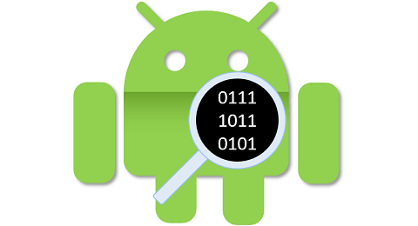
Anti-Reversing Code
Anti-VM Code:
18/20
Anti-Debugging Code:
10/20

Slide 14


3rd Party Risk Ratings
MobSF:
38/100 Average Security Score
VirusTotal:
6 Apps were flagged as malicious on Virustotal
Of the apps that were flagged, there were an average of 16 vender flags per app

Slide 15
Findings

Slide 16
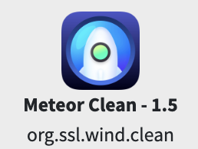
Meteor Clean
Security Score - 46/100
Top Abused Malware Permissions (Via MobSF) - 15/25
Virustotal Community Score - 14/64
Notes:
The app that I selected to do a deep dive into was Meteor Clean
Compared to the other apps, it has a higher than average security score, although it has the highest amount of abused malware permissions according to MobSF.
Additionally, it was flagged on Virustotal, receiving 14 flags from vendors.

Slide 17
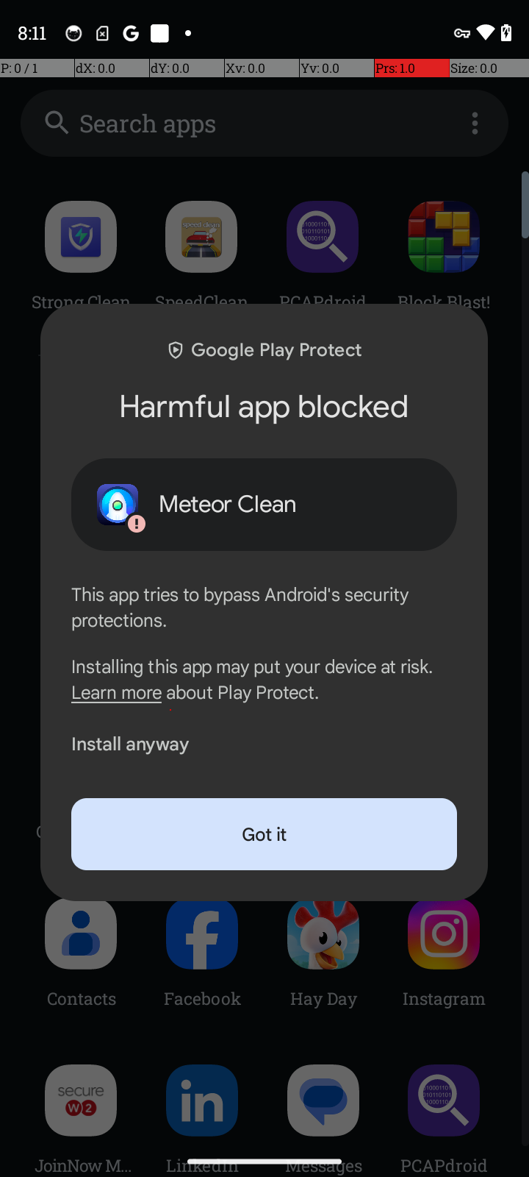
HiddenAds Malware
8 out of 14 of the Community Flags identify this app as containing HiddenAds Malware.
HiddenAds is a type of malware that disguises itself as a legitimate app, run malicious services upon installation
Displays intrusive advertisements and harvests sensitive user data

Slide 18
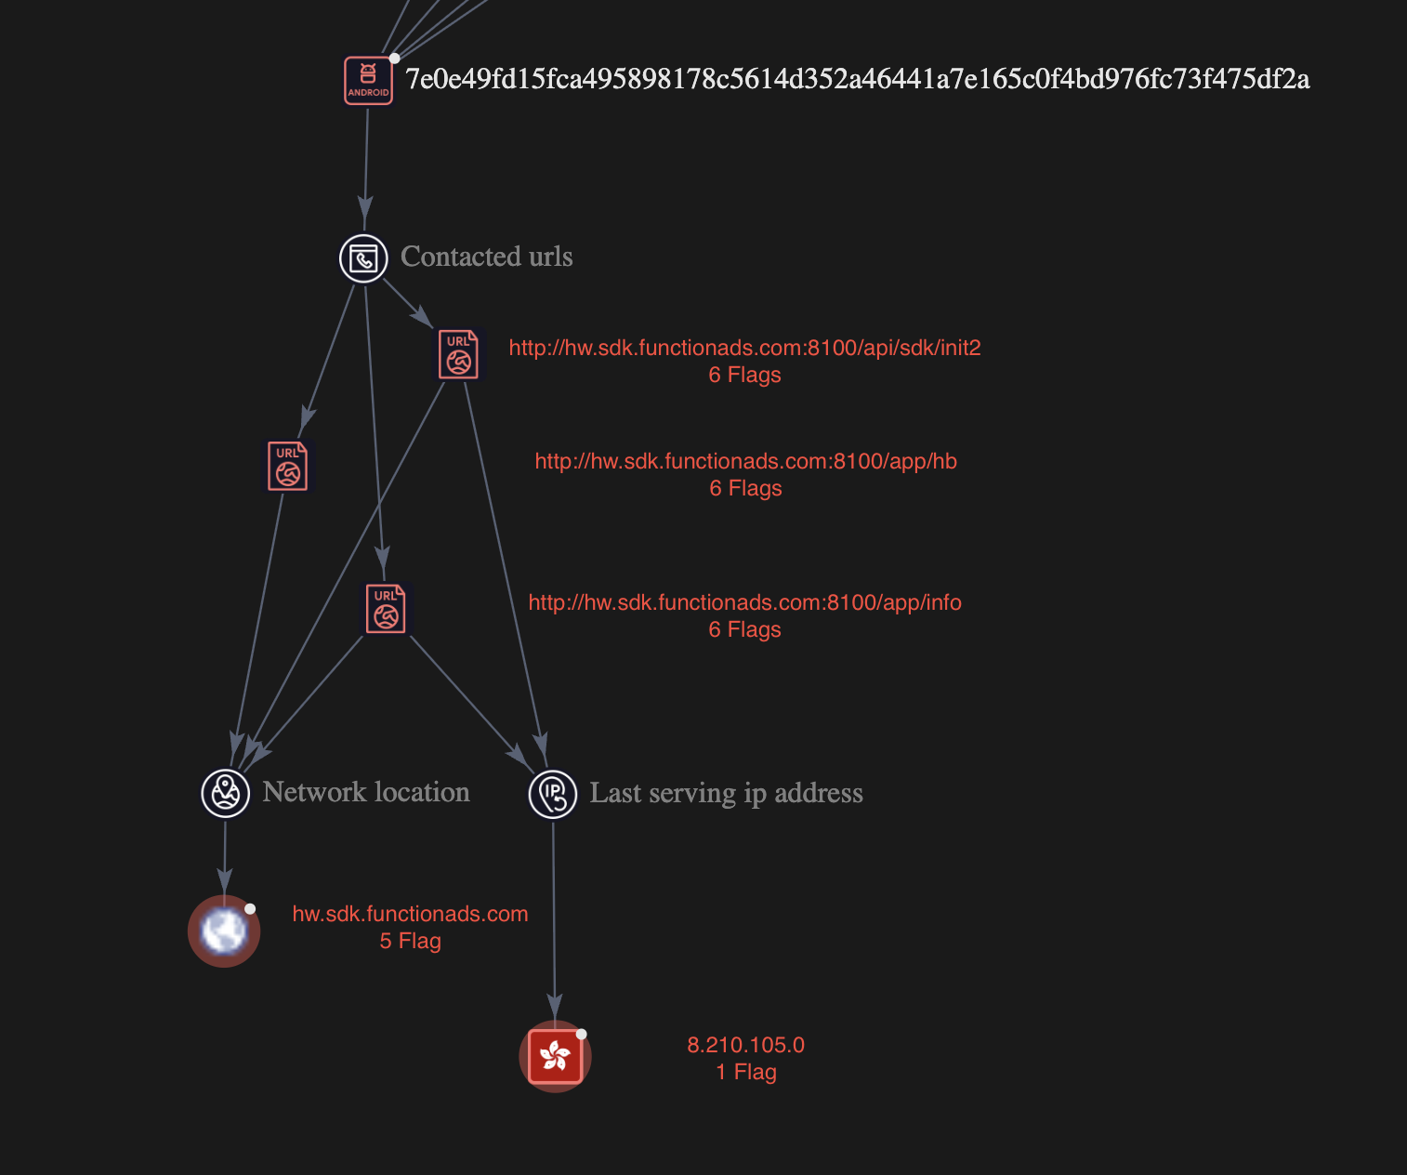
Virustotal Threat Graph

Slide 19
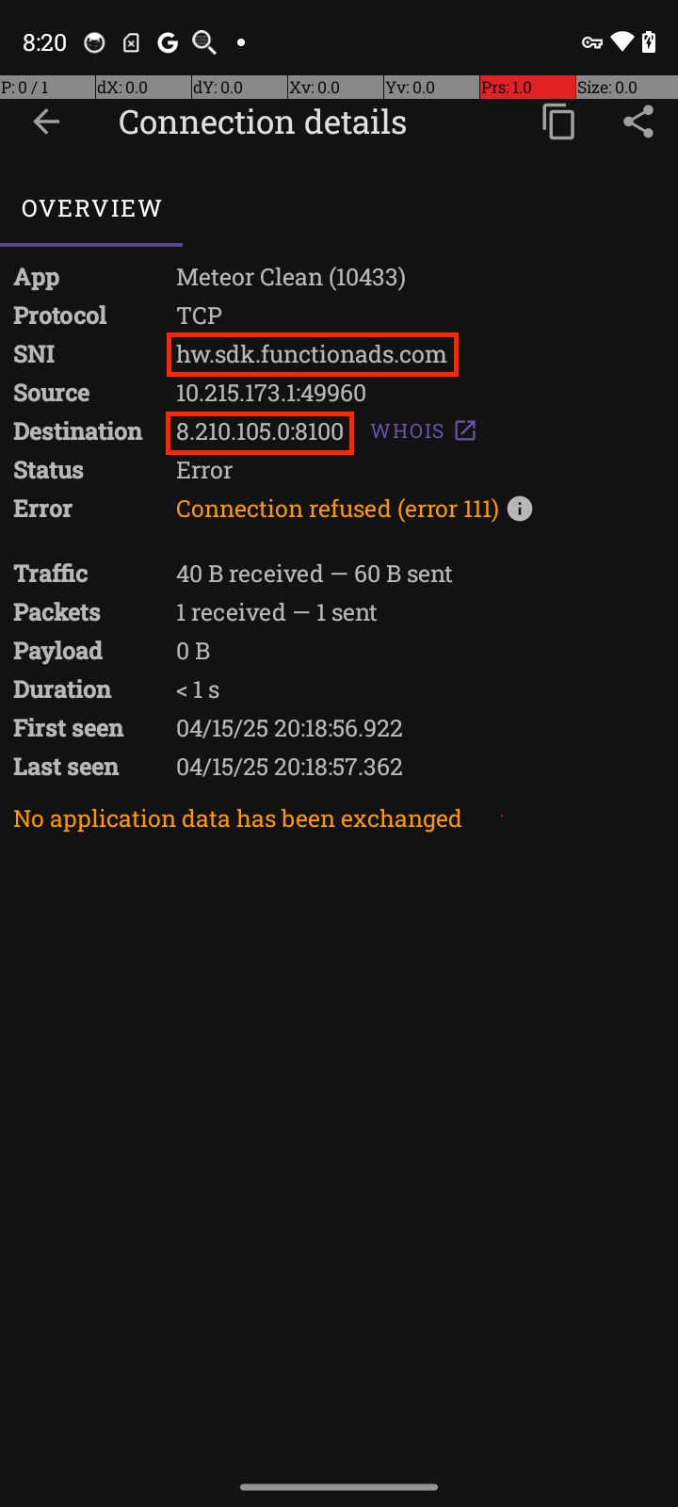
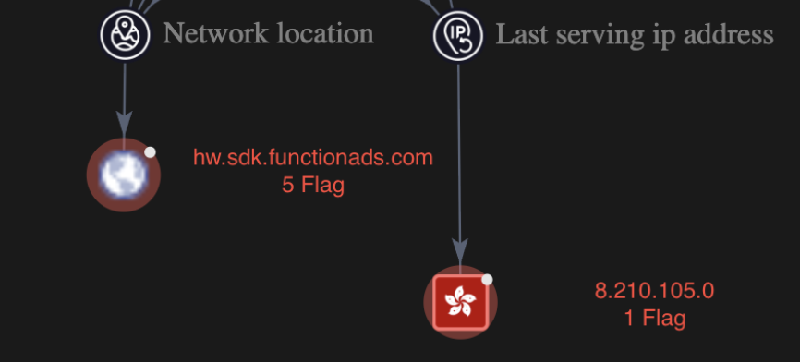
Packet Capture
Meteor Clean attempted to communicate with the same server at the same IP that was identified on Virustotal

Slide 20
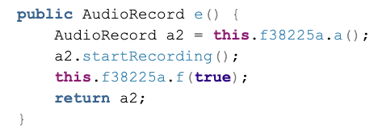
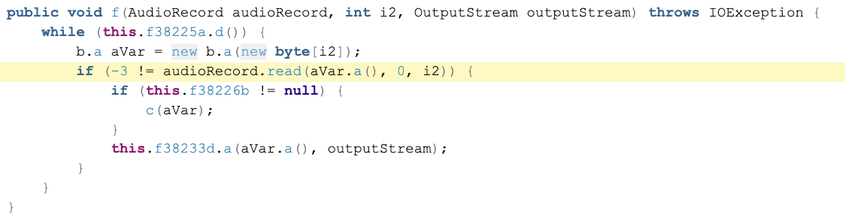
u/g.java - Uses android.permission.RECORD_AUDIO
Starting Audio Recording using AudioRecord
Reads Audio from AudioRecord instance and writes to the outputStream

Slide 21
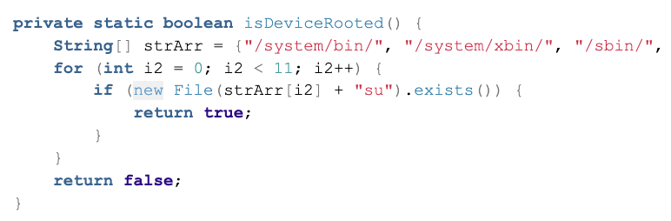
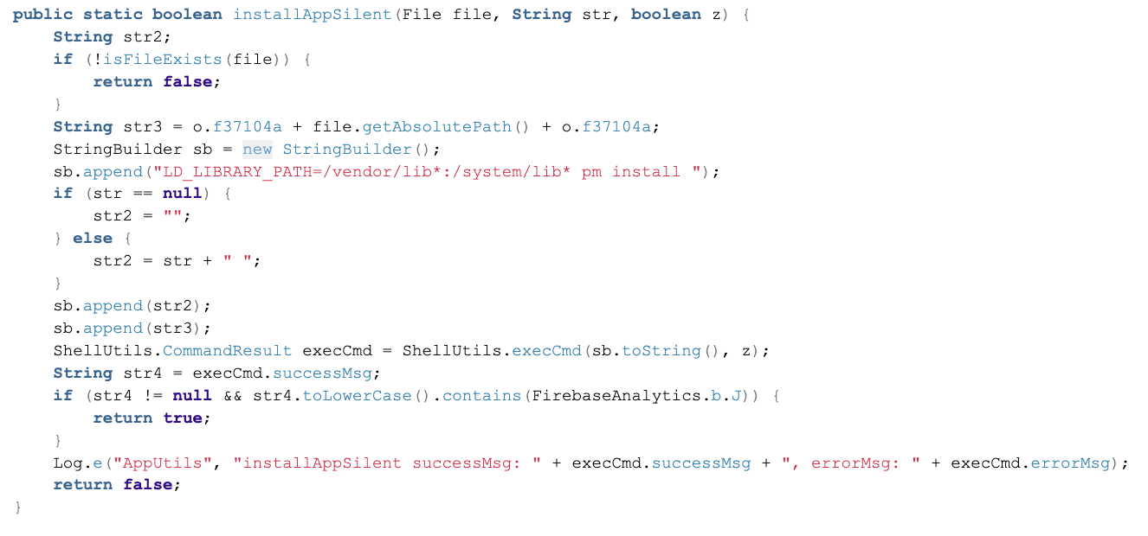
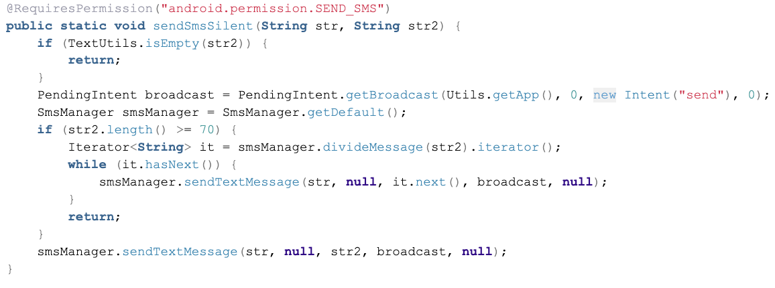
DangerousUtils.java
Multiple extremely suspicious functions that aren’t used in the apk

Slide 22
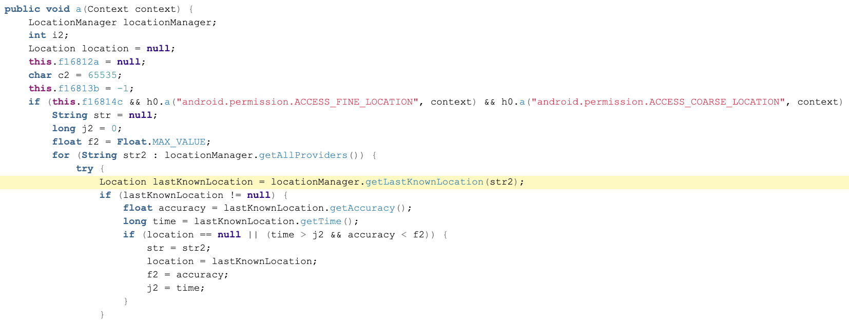
com/my/tracker/obfuscated/y.java
Gathers location data that seems to be more extensive than standard ad location collection

Slide 23
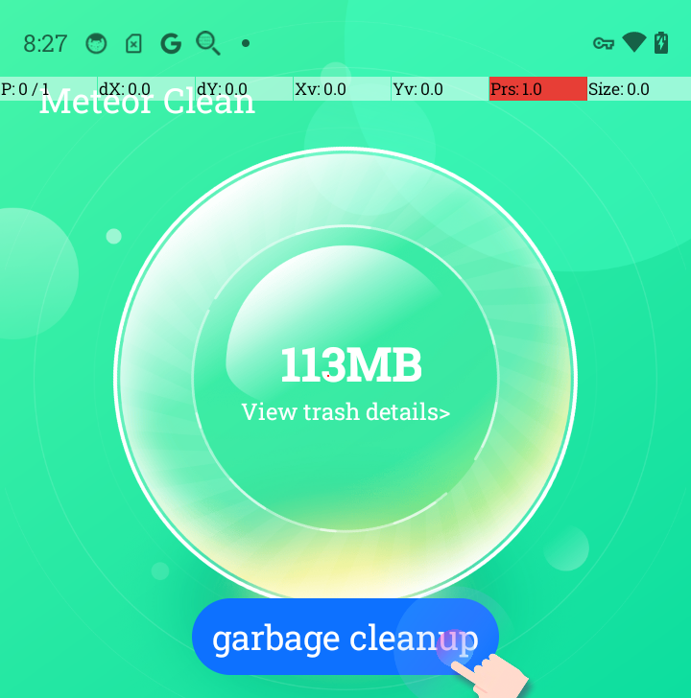
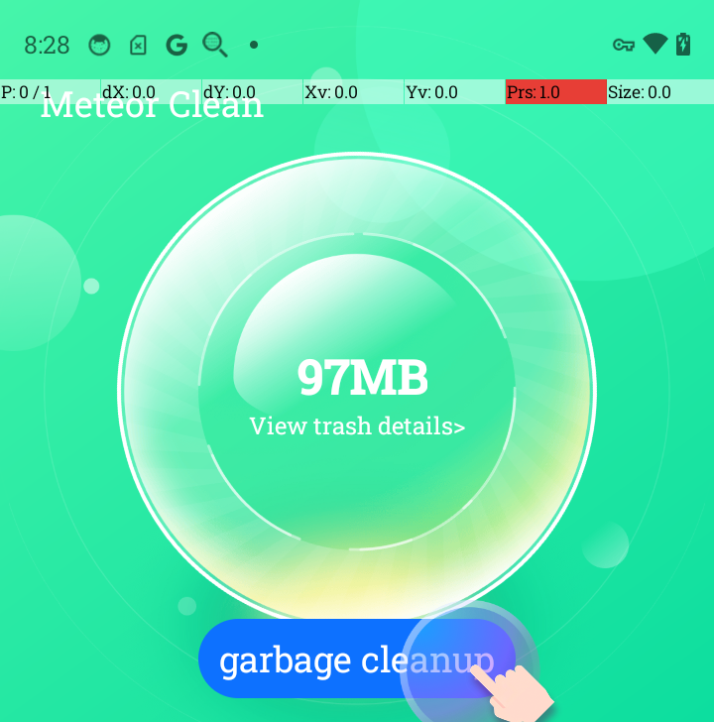
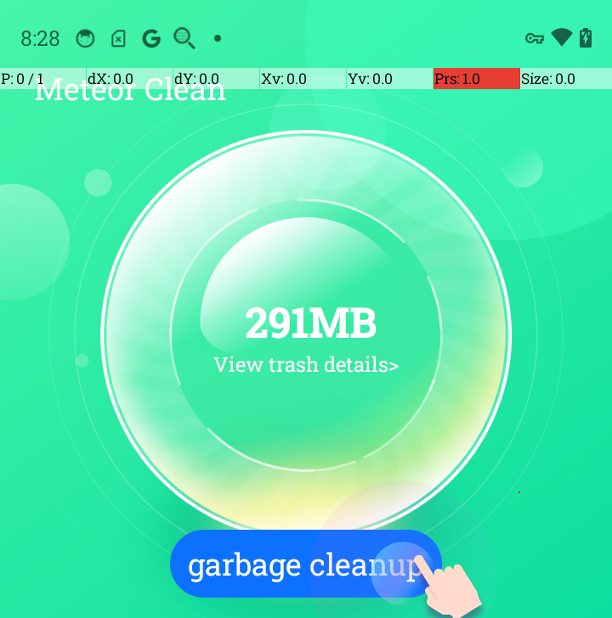


Experiment
8:27
8:28
8:28
8:28
8:30
The “garbage cleanup” button was NOT pressed in between app openings

Slide 24

SpeedClean
In-app “functions”
  Junk Clean
  Phone Booster
  App Manager
  Battery Saver
  CPU Cooler
Not in app store
MobSF score: 48
VirusTotal score: 18/64

Slide 25
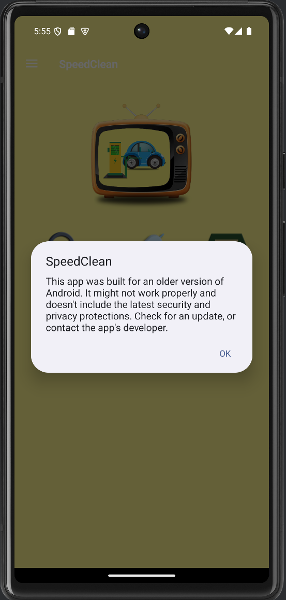
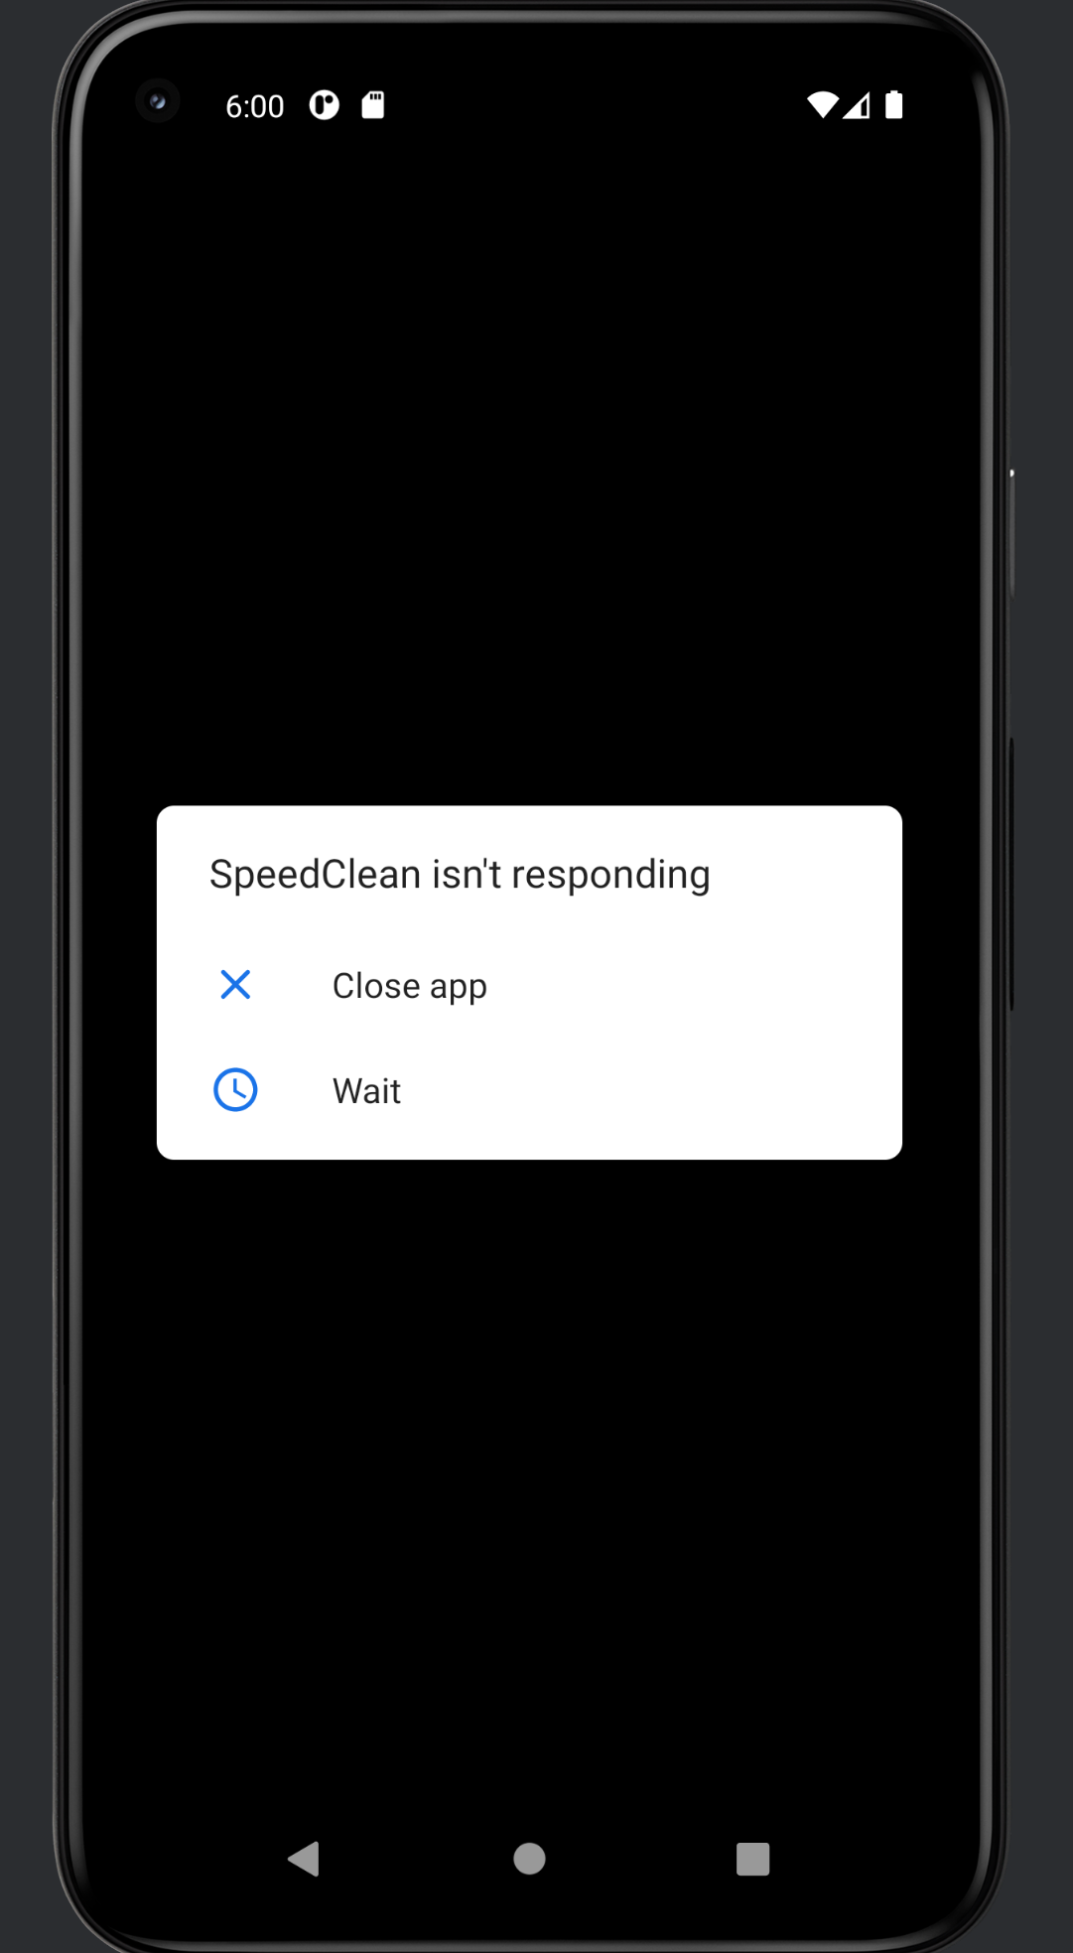
SpeedClean
Unable to run properly in VM
  MobSF - Anti-VM Code
  Built for an older version of Android
  Still failed

Slide 26
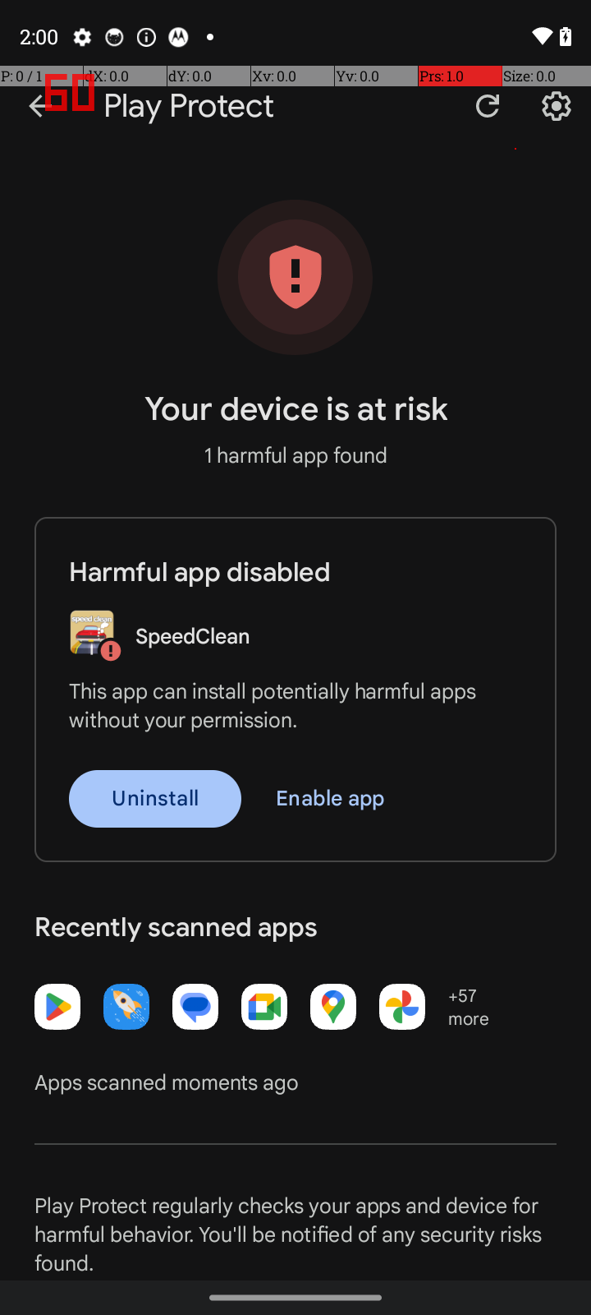
SpeedClean
Finally installed on an Android phone
Immediate warning when installed through adb
Potentially Dangerous Permissions used:
  ACCESS_NETWORK_STATE
  GET_ACCOUNTS
  INTERNET
  ACCESS_WIFI_STATE
  READ_PHONE_STATE
  WAKE_LOCK
  WRITE_EXTERNAL_STORAGE
  REQUEST_INSTALL_PACKAGES

Slide 27
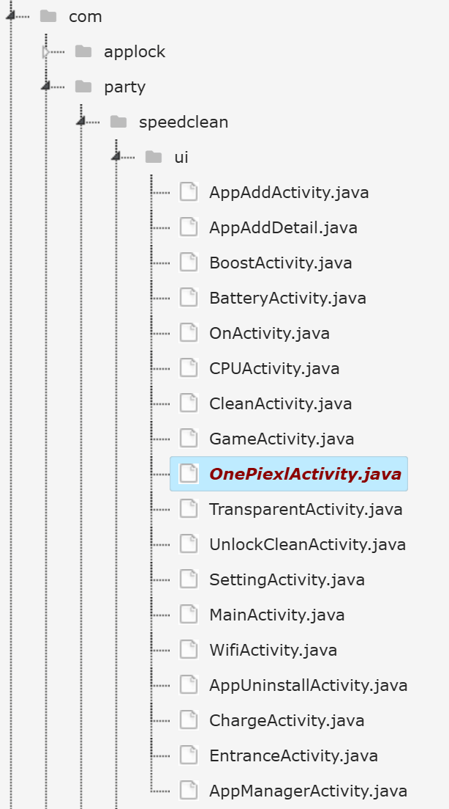
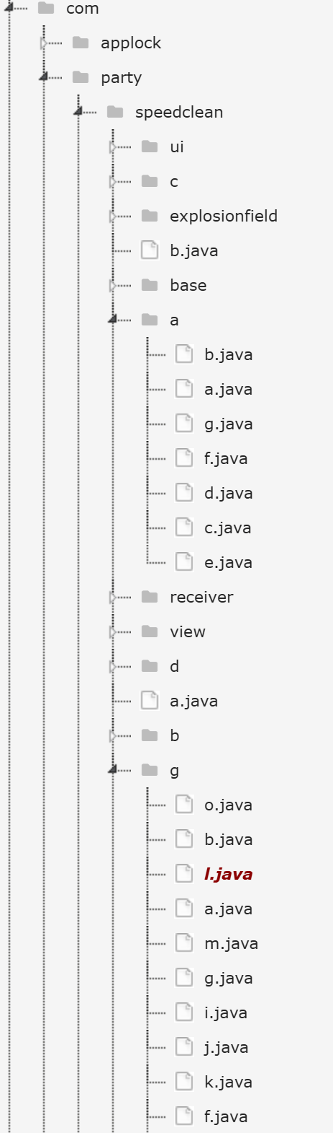
SpeedClean
Not completely obfuscated
Intentionally confusing

Slide 28
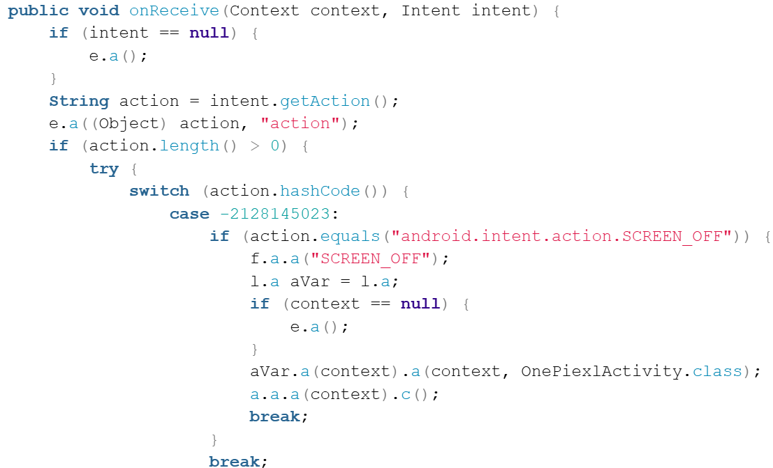
SpeedClean - mReciever
Case: SCREEN_OFF
Log event
Start OnePiexlActivity
Shut down app lock timer
Why?
  Persistence
  Tasks are uninterrupted by lock screen
  Allows it to remain active

Slide 29
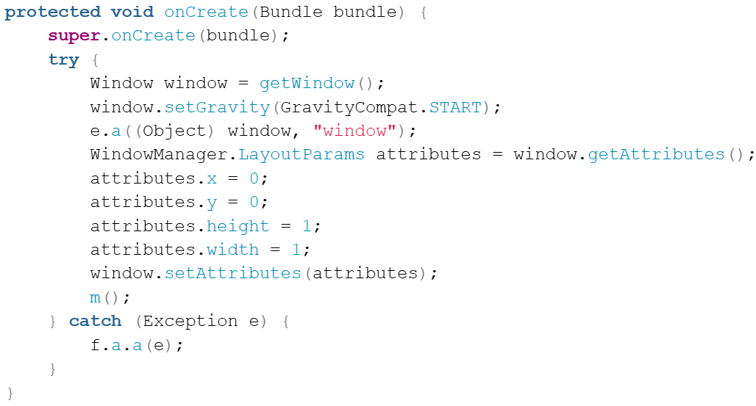
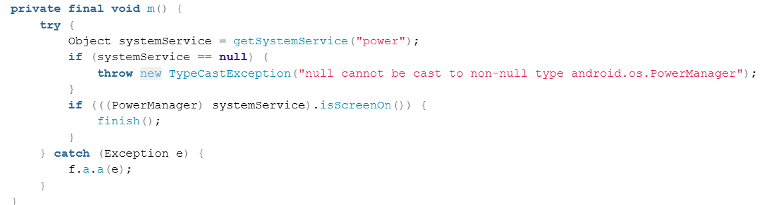
SpeedClean - OnePiexlActivity
Creates a 1x1 pixel activity
Used in mReceiver
Immediately finishes the activity when screen is turned on

Slide 30
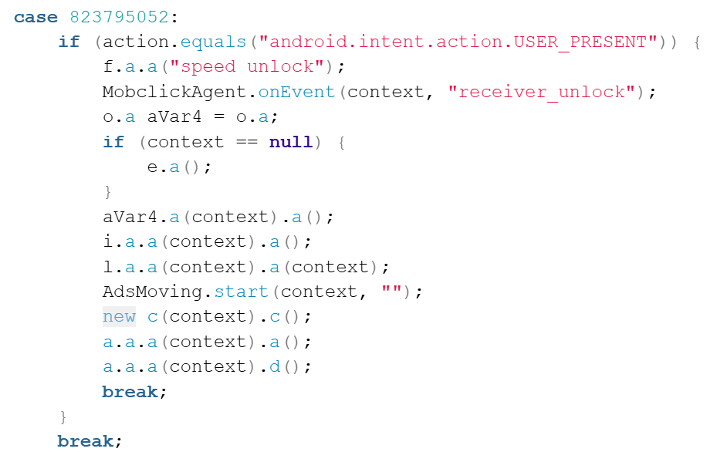
SpeedClean - mReciever (cont.)
Case: USER_PRESENT
Log event as “speed unlock”
Send analytics to umeng
o.a creates instance which attempts to refresh the ad cache
Call to g.l
Initialize ads

Slide 31
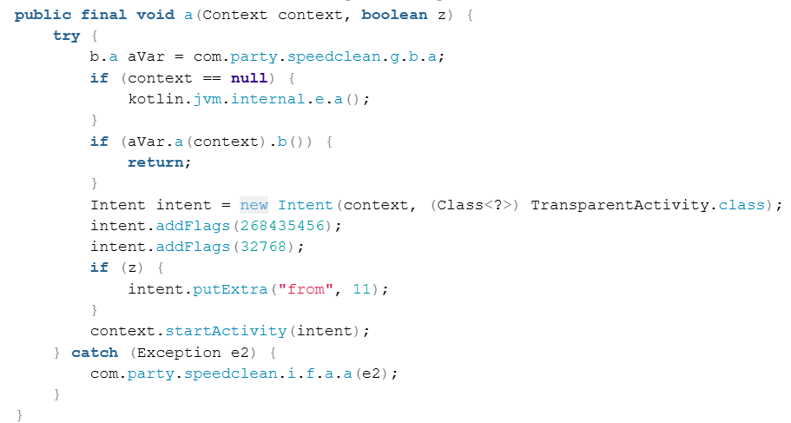
SpeedClean - g.l
Run through checks to ensure it can be started
  If no context passed
  If there is an app UI in frame
Calls TransparentActivity

Slide 32
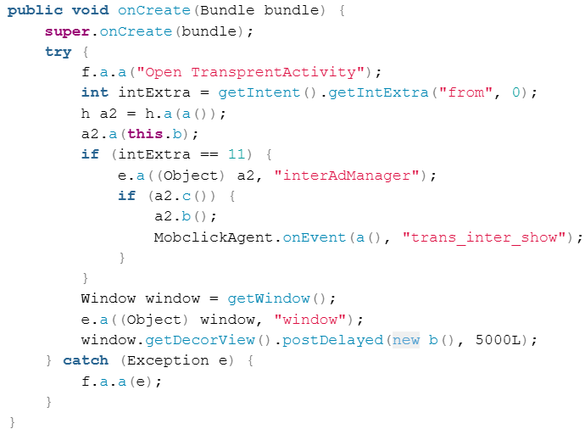
SpeedClean - TransparentActivity
h.a() loads the ads
this.b = check if add is ready
If so display it with transparent activity

Slide 33
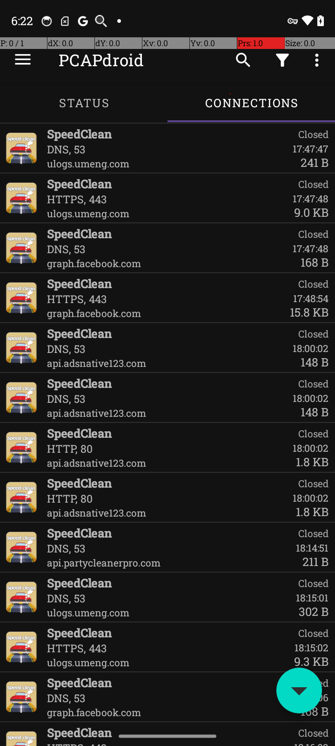
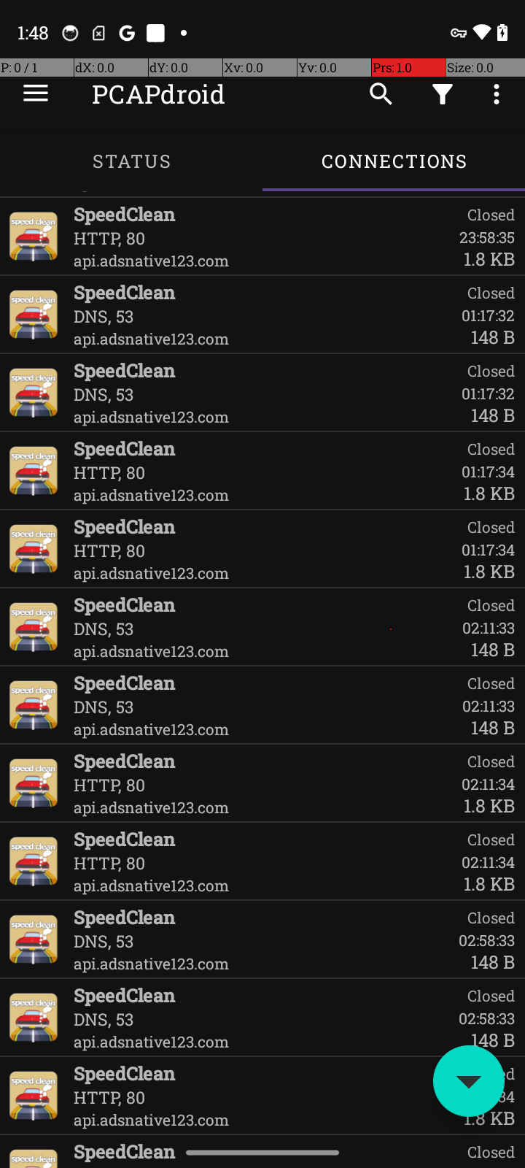
SpeedClean
ulogs.umeng.com
  Sent when app is opened
  Origin: mReciever-USER_PRESENT
Ads pulled from:
  Facebook
  Adsnative
  Partycleanerpro
Never seen while using app
Triggering while screen is off

Slide 34
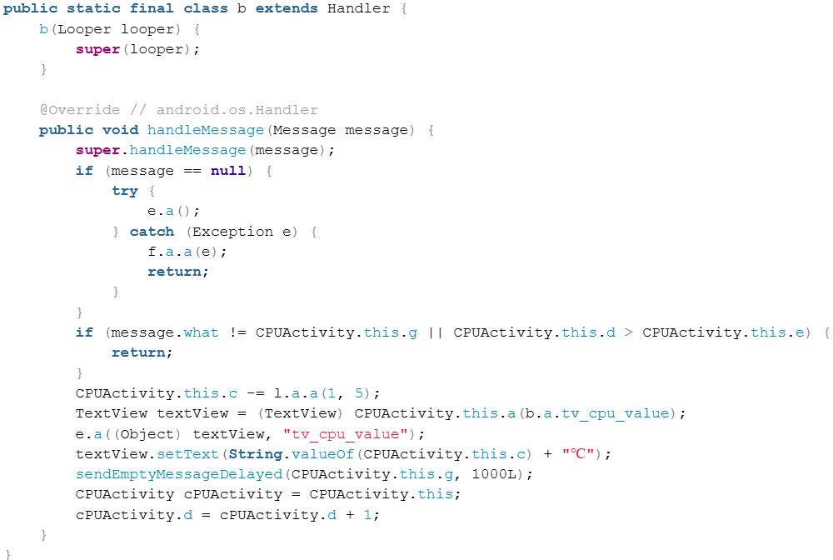
SpeedClean’s Silly Antics
“CPU Cooler”
CPUActivity.this.c -= l.a.a(1,5);
Not g.l.a.a, instead uses i.l.a.a
i.l.a.a(int1, int2) generates random number between int1 and int2

Slide 35
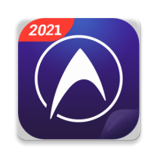
DU Speed Booster
App Name: DU Speed Booster (com.limsky.speedbooster)
Marketed as:
  Phone cleaner
  battery saver
  CPU cooler
MobSF Security Score: 0/100 (Critical Risk)
VirusTotal Community Flags: Multiple AV engines report adware & potentially unwanted behavior

Slide 36

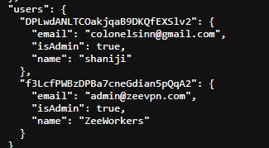
DU Speed Booster - Raided Firebase
Firebase database was publicly accessible — no authentication
Hardcoded in the APK: firebase_database_url
Data included sensitive keys, user credential patterns:
  password, username
  <cert>, <key>
  Public .json
  users table
  gesture_pwd, number_pwd
https://zeevpn-fca47.firebaseio.com/.json
Notes:
The DU Speed Booster app contains a hardcoded reference to a publicly exposed Firebase backend. This was confirmed through static analysis tools like MobSF, which extracted the URL during its inspection of resource and code strings.
<cert>, <key>
OpenVPN private keys — total compromise of VPN security
Public .json
No auth needed — anyone on the internet can read & modify
users table
Lists admins — enables targeted phishing attacks
gesture_pwd, number_pwd
Shows password methods used (gesture, PIN, fingerprint), giving insights to attackers

Slide 37
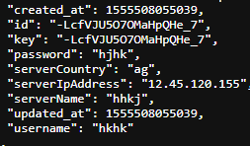
DU Speed Booster - Raided Firebase Cont.
OpenVPN Client Configuration
Core Settings
Cryptographic Materials
  CA Certificate
  Client Certificate
  Private Key
  TLS Auth Key
Notes:
This is like taping a full credit card and PIN to a public wall — it contains the keys, the certificate, and the lockpick. Anyone on the internet can use this to connect to the VPN server, eavesdrop on traffic, or impersonate another user — all without logging in.
Private Key
Anyone can impersonate a legitimate VPN client and access the network
Remote Server Info
Enables targeted attacks or unauthorized VPN access
Client Cert + Key
A complete authentication identity that bypasses login screens
Public Access
No auth required to download this from Firebase → total exposure
This Firebase database acts as a free credential vending machine for OpenVPN. Any malicious actor could:
Clone the connection setup
Access private internal networks
Manipulate VPN traffic
Launch MITM (man-in-the-middle) attacks

Slide 38
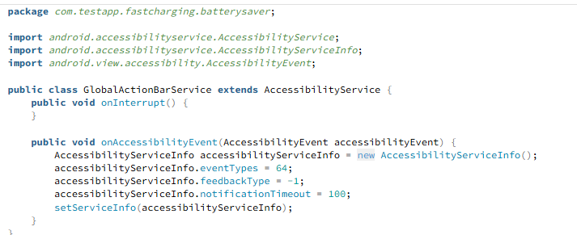
DU Speed Booster - BatterySaver??
Notes:
This code sets up an accessibility service that monitors window changes. Right now, it's benign — it just configures the service and does nothing else — but the use of accessibility APIs, the suspicious feedback type (-1), and placement of logic in onAccessibilityEvent() are red flags. With additional logic, this could be abused for:
App usage tracking
UI automation
Credential stealing
Overlay/click fraud
Dynamic Code Loading
DexClassLoader in DynamicLoaderFactory.java
Loads new code at runtime — bypasses app store checks
Persistent Background Activity
startForeground() in BatteryService.java, AlarmReceiver.java
Keeps processes alive silently, often used to reload services after kill
Hidden WebViews
loadUrl(), addJavascriptInterface() in ad SDKs & WebViewManager.java
Can invisibly load ad pages, simulate interaction, or harvest data
Excessive Scheduling APIs
AlarmManager, JobScheduler, postDelayed()
Launches background jobs repeatedly, possibly to trigger ads
Aggressive Ad SDK Use
Multiple AdActivity & FirebaseAnalytics references
Tracks user behavior, serves personalized/injected ads
Obfuscated Control Files
Remote Firebase storage & deferred downloads
May update ad routines or payloads post-install

Slide 39
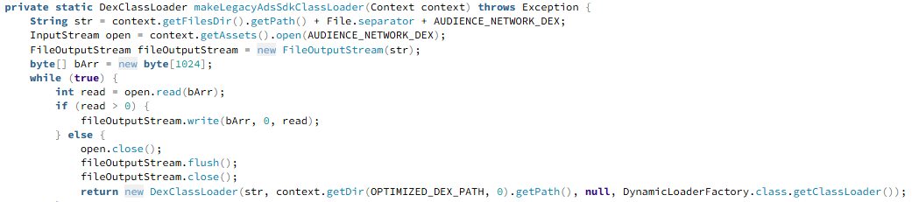
DU Speed Booster -
Dynamic Code Loading
File: DynamicLoaderFactory.java, MultiDex.java, zzez.java
Uses DexClassLoader:
Allows the app to download and run new .dex (code) files after installation
This is used to evade Play Store and static scanners
Dangerous because it can turn benign apps into malware on demand
Notes:
This app dynamically loads an embedded .dex file at runtime using Facebook’s Audience Network SDK — bypassing static code scanning. This allows it to inject new ad modules, potentially simulate clicks, and keep itself alive with foreground services. Combined with hidden WebView use and job scheduling, it creates the perfect environment for ad fraud or evasive behavior.
Loads external .dex files dynamically
Can inject new behavior at runtime — including ad fraud or spyware
Uses fallback and retry mechanisms
Evades crashing and hides failure from users and analysis tools
Dex is stored in assets
Not visible in manifest; not scanned like compiled code
Execution path is abstracted away
The core functionality is only triggered after install — great for evading MobSF and VirusTotal
Backed by ad SDK (Facebook)
Can simulate ad views, clicks, or harvest tracking data silently

Slide 40







DU Speed Booster - IT'S JUST ADFRAUD
Notes:
“This isn’t just sloppy coding. It’s deliberate. DU Speed Booster sets up a hidden infrastructure using standard Android services to simulate clicks, load WebViews in the background, and keep those tasks alive even after the app is closed. All while dynamically loading new ad fraud modules that avoid static scanning.”
“This is a blueprint for ad fraud: evasive, persistent, and profitable.”
What’s marketed as a cleaner app is actually a backdoor for surveillance. DU Speed Booster uses SDKs like Facebook Audience Network to load dynamic ad modules after install, keeps background services alive, silently injects WebViews, and tracks your behavior. The app earns money through ad impressions and clicks — not by cleaning your phone

Slide 41

Super Booster - Smart Cleaner
MobSF Security Score: 10/100 (Critical Risk)
-Highlights-
Fake optimization UI with no real cleaning logic
Rewarded ad fraud via multiple SDKs
Firebase Analytics spoofing
Persistent user tracking with MMKV
Remote control via Firebase Config

Slide 42

MobSF Report
Security Highlights:
App Security Score: 10/100 (Critical Risk)
Trackers Detected: 17
CVSS Score Average: 6.3
Permissions Requested: 47+ (many are dangerous/system-level)
Key Red Flags:
Excessive permissions like:
  SYSTEM_ALERT_WINDOW (screen takeover)
  MANAGE_EXTERNAL_STORAGE (full file access)
  ACCESS_FINE_LOCATION, GET_ACCOUNTS, AUTHENTICATE_ACCOUNTS
Anti-VM & anti-debugging checks across multiple .dex files
Obfuscated code with unreadable methods and fields
Remote WebView debugging enabled — opens path for remote code execution
Unprotected exported components (e.g., services, receivers, activities) that can be abused by other apps

Slide 43
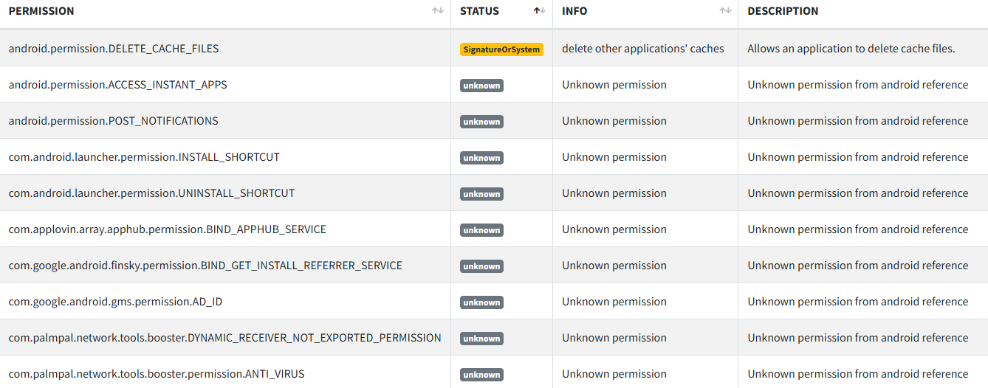
MobSF Report 2
Some strange permissions

Slide 44

Obfuscation
THERE WAS
A LOT……

Slide 45
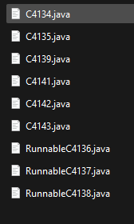
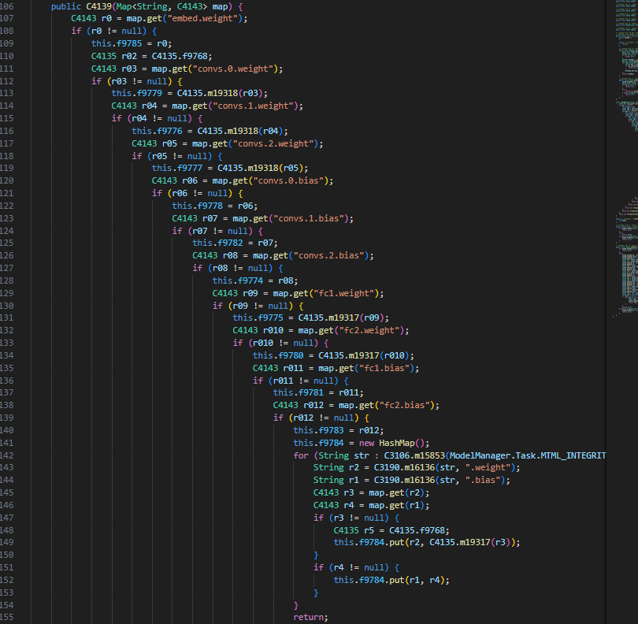
Obfuscation Part 2
What’s going on in those fun folders?
A good example!
C4139.java is a ML model, with
weighted response values

Slide 46
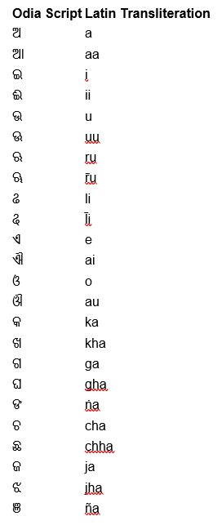
Obfuscation Part 3
Yes, it is obfuscation not just another language
The language is Odia
Intentionally used characters that would not display correctly for most machines.

Slide 47

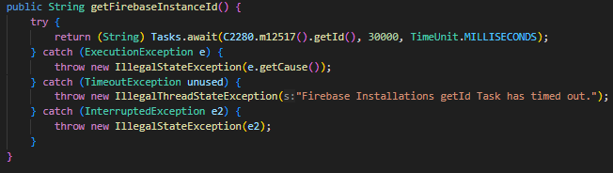
FireBase Analytic Spoofing
Fake analytics events
Simulates screen active for engagement
Fetches unique instal ID
Notes:
1. Remote Config + MMKV Flags
Firebase Remote Config fetches values like:
java
CopyEdit
reward_auto_trigger = false
ads_enabled = false
These values are cached locally in MMKV:
java
CopyEdit
MMKV.defaultMMKV().getBoolean("ads_enabled")
During review, these values are set to "false".
2. After Approval, Firebase Updates Values
On a real user’s device, Firebase may return:
json
CopyEdit
{
"reward_auto_trigger": true,
"ads_enabled": true
}
Now the app silently activates:
Ad SDKs like Vungle and IronSource
Fake reward logic
Spoofed Firebase analytics events
✅ 3. Behavior Changes Without App Update
No need to push a new APK or request permissions
The fraud logic is already inside the app, just dormant
All it takes is a toggle from Firebase — invisible to Google Play Protect or static analysis

Slide 48
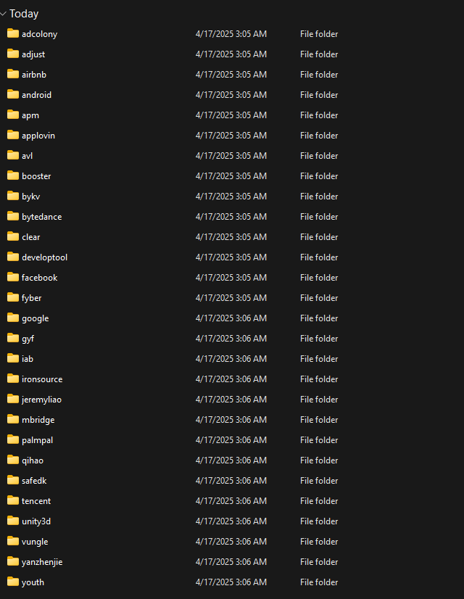

Adware - it’s all just ads!
Adcolony
Facebook
Vungle
Ironsource
And many more!

Slide 49
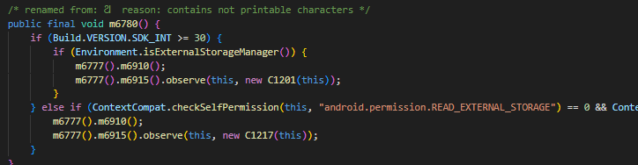
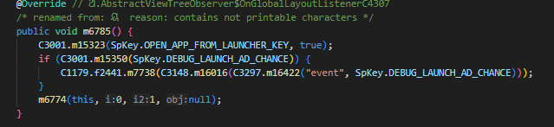
It’s all hardcored junk!
Looking for permission doing nothing with them and launch an ad/ logging behavior
Notes:
Pretends to check permissions and then triggers something like a “cleaning” animation or flag, but it’s likely tied to FunctionViewModel, which might trigger ad-related logic instead.
This logs a “launch event” and checks a debug key to possibly trigger an ad immediately on app launch — often a red flag in fraudulent apps.

Slide 50
SDKs that are deeply embedded
SDK | Function
Vungle | Interstitial/Rewarded ads
AdColony | Rewarded ads, spoofed event responses
IronSource | Reward events via WebView/JS
Fyber | Mediation
AppLovin | Possibly via SafeDK
Firebase | Analytics & Remote Config
MMKV | Local flag toggling to enable ads
Notes:
Firebase (Analytics, Remote Config, Installations)
Analytics, backend config, and device ID tracking
- Logs fake engagement (e.g., "Boost_Complete")
- Tracks Installation ID across sessions
- Uses Remote Config to toggle fraud ON/OFF remotely
Vungle
Rewarded and interstitial ads
- Auto-triggers ads with no user action
- Preloads ads silently in background
- Tied to fake events and MMKV flags
AdColony
Video & rewarded ads
- Hooks into reward logic from spoofed UI states
- Used via AdColonyReward class
- Possibly fakes “completed view” without showing ad
IronSource
Mediation, rewarded ads
- Uses JavaScript bridges to simulate user clicks
- Launches interstitials on “clean complete” events
- May falsely log reward completions
Fyber
Mediation & ad monetization optimization
- Dynamically prioritizes ad revenue sources
- Possibly used to rotate SDKs in/out based on Firebase toggles
AppLovin
Ad mediation, full-screen ads
- Likely embedded via SafeDK
- Could be injected into reward chain with little visibility
- Operates stealthily if toggled via remote config
SafeDK
SDK monitoring and injection
- Injects/patches SDK behavior at runtime
- May allow switching SDKs in/out based on sandbox detection or install referrer spoofing
- Hides SDK presence during scans or first launch
MMKV (Tencent)
High-speed key-value storage
- Stores ad behavior flags, like reward_auto_trigger or ads_enabled
- Used with Firebase to cache remote config flags locally
- Persists state across launches (e.g., “has seen ad today”)

Slide 51

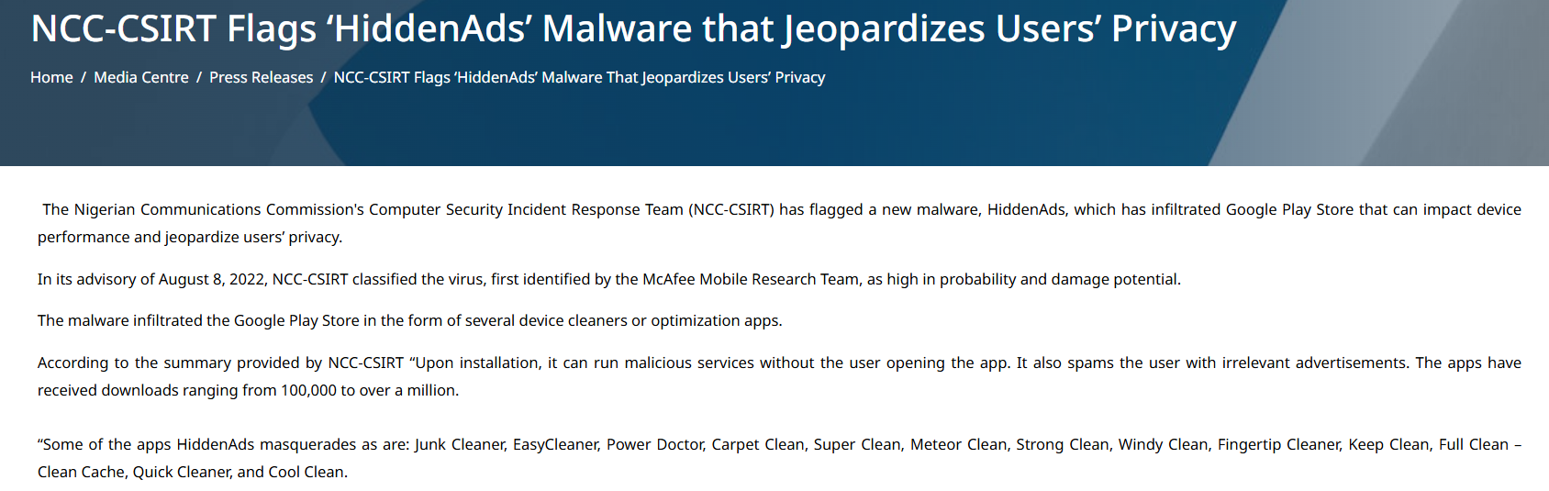
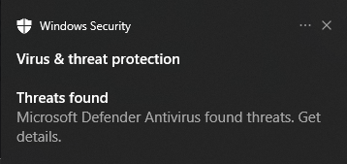
Fingertip Cleaner
This app requests 48 permissions, from get_accounts() to set_alarm()
Flagged on VirusTotal as a variant of “Hiddad”

Slide 52
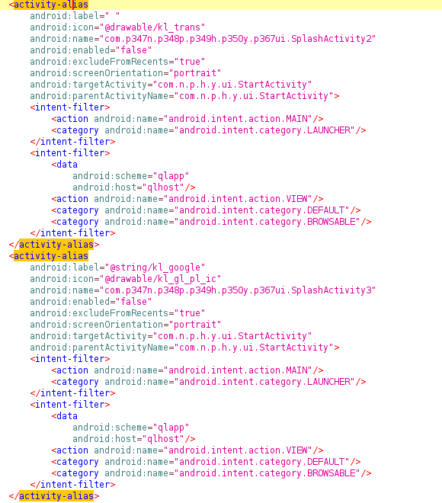
Hiddad/HiddenAds
Install normal app, hits you with lots of adds
Normal app tries to install another malicious service
Malicious app changes its appearance and hits you with even more ads
“Splash activity” just opened settings

Slide 53
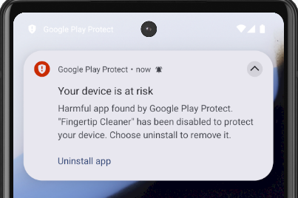
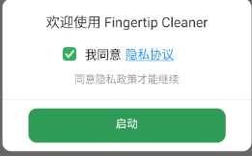

Root Detection
Very classic way to see if the device is rooted
If your device contains the su binary in one of the 11 listed places, it returns true, and most likely limits functions of the app
I was going to use a non rooted AVD to test but …
So I had to tell the AVD to let it through
Still nothing, so moved to a physical phone

Slide 54




Fake Buttons?
Surprisingly the buttons don’t actually do anything
This is the “Cache cleaner”
Tricks user into thinking it's being productive

Slide 55
Nothing is real, everything is fake
Almost everything gets cycled back to this section of the code, so it can return your success message
Sometimes there are lockouts, that try to keep suspicion low
One of the functions that you’d expect to do the “cleaning” literally is just hundreds of lines of animations

Slide 56

Ads
Android
Google
Bytedance (Tiktok)
Chartboost
Huawei
Inmobi
Analytics
Ironsource
Unity3d

Slide 57

More Stuff
Creates a new account with the package name
Couldn’t fully dive into what the account was used for
This account is used for syncing
Never was able to find this account on the test phone(s)

Slide 58


More Pt. 2
Creates notification banner
Creates an alarm for 18 seconds
When alarm is done, it triggers the banner again, keeping the app running
C3906H Class handles ads for every button press, and has timeout function for 10 seconds
Given the right permission, the app interrupts every action with a pop up, making you open the app again

Slide 59
Conclusion

Slide 60

Don’t use these apps
These are only some of the tactics used by these apps
None of the apps we looked into had any real purpose

Slide 61


Alternatives
Use backed cleaners
  https://github.com/d4rken-org/sdmaid-se
    Free and paid models
Clean cache manually through the app
Use android's storage to see what's actually taking up space

